Slide 1
Biophysical (LAI/FAPAR)
Leads: H. Fang (CAS), S. Leblanc (CCRS), and M. Weiss (INRAE)
Guidance from F. Camacho (EOLAB, Valencia)
Regular reviews and updates
Homepage
Products
Collaboration
References

Slide 2
Protocol update
Biophysical focus area protocol
Had a couple of telecons to discuss the protocol (M. Weiss, F. Camacho and H. Fang)
Decide to merge FAPAR & LAI into a biophysical protocol
A small group will start to work on the skeleton
Identified potential contributors (B. Brede, L. Brown, Q. Xiao)
Submit as a journal paper

Slide 3
Recent CGLS products and validation
The CGLS Sentinel-3 300 m LAI/FAPAR available from July 2020 (https://land.copernicus.eu/global/themes/Vegetation).
Operational PROBA-V mission/products (300 m, 1 km) ended on June 30, 2020
The CGLS 1km product has stopped updating
Validation of the CGLS Sentinel-3, EUMETSAT EPS, NASA/NOAA VIIRS LAI and FAPAR products at GBOV-NEON sites is ongoing

Slide 4
LAI S3 (RMSD=0.864) EPS (RMSD=1.097) VIIRS (RMSD=1.144)
FAPAR S3 (RMSD=0.128) EPS (RMSD=0.165) VIIRS (RMSD=0.171)

Slide 5
Fiducial reference networks
ESA FRM4Veg phase 2
Next field campaign in Wytham in July (EOLAB, U. Southampton)
Protocols for field measurements and uncertainty propagation can be shared
Respond to ESA LPV
Cal/Val database [LPV-REC-19]: a centralized repository of Cal/Val data for land (ESA host or an “open” option)
Cal/Val sites collection [LPV-REC-21]: evolution of BELMANIP sites for S2 resolution (10 m)
Fill the geographical gaps (Africa, Asia, South-America)
Evolution of OLIVE platform
Currently out of date, needs financial support for continue

Slide 6
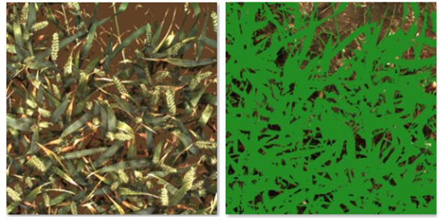
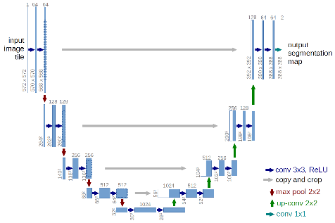
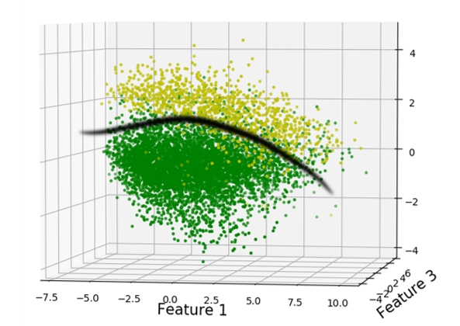
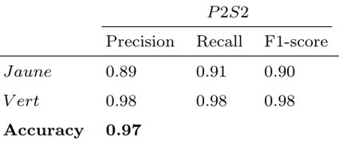
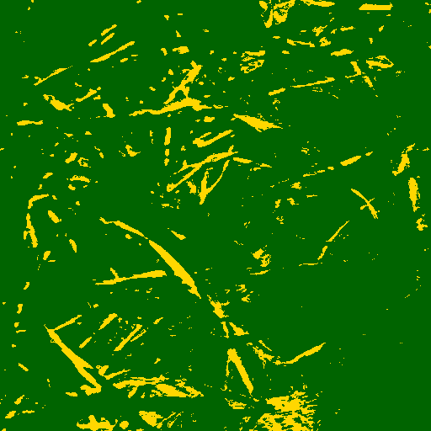
Automatic DHP/DP processing
Deep Learning
Architecture- U-NET
Vegetation / Background
300 labelled patches
1120 images refined
(Training DL model)
Precision=0.83
Recall= 0.97
F1-score=0.89
SVM
Yellow
Green
Green/Senescent
From Madec S., Serouart M., Weiss M. , Irfan K., Baret, F.

Slide 7
Gaofen validation network (China)
42 sites enlisted, all land surface ECVs
National standards (protocols) enacted
Measurement initiated
PI: Xingfa Gu <guxingfa@radi.ac.cn>

Slide 8
Decametric products
Landsat LAI over US (Kang et al., 2021)
Validated over GBOV-NEON sites and compared with MODIS LAI
(https://doi.org/10.1016/j.rse.2021.112383)
Sentinel-2 over Europe will be launched this summer (EEA Copernicus Land Monitoring service).
P2S2 for the validation of S2 LAI/fAPAR
Ongoing over ESUs in France & Belgium

Slide 9
UAV for validation
UAV4VAL, Dragon-5 project between U. Southampton, NPL, and Wuhan University
Exploiting UAV for validation of Sentinel-2 and GAOFEN-6 reflectance and biophysical products.
UAV measurements will be conducted over several sites of China and Europe (http://dragon5.esa.int/projects/)
IGARSS’21 invited session
MO1.O-4: UAV and Low-cost Sensor Networks for Land Monitoring and Cal/Val

Slide 10
Emerging validation needs
Separate green and non-green components
Vertical layered products
GEDI 5 m PAI profile (https://gedi.umd.edu/data/products)
GCOM-C total and overstory LAI & FAPAR (250 m, 2018.12-) (https://suzaku.eorc.jaxa.jp/GCOM_C/data/product_std.html)
GLOBMAP total and overstory LAI (500 m, 8-day, 2000-) (https://doi.org/10.5281/zenodo.4700264)
Geostationary products
EUMETSAT LSA-SAF LAI/FAPAR (daily, 3 km)
(https://landsaf.ipma.pt/en/about/catalogue)
NSMC/China Fengyun land products (under development)
(http://satellite.nsmc.org.cn/portalsite/default.aspx)

Slide 11
Actions for the next future
Biophysical protocol update (AP: 19-LPV-15)
Support ESA for the datasharing platform (ESA LPV REC-22)
Gather existing data at decametric resolution (easier than for coarser resolution)
Define the characteristics of the platform
People can freely provide their dataset (either the data or the link to the data) with associated documentation, providing they follow the measurement protocols
Follow the FAIR principles (Findable, Accessible, Interoperable and Reusable)
Need to define standards for metadata, quality information, and documentation (ESA, LPV-REC-05)
Newsletter to the community

